Slide 1



Slide 2
Contents
1
Insertion sort
2
Sorting algorithm demo
3
Merge sort

Slide 3


Slide 4

Selection Sort

Slide 5
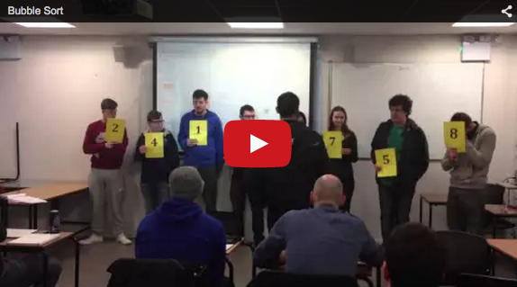
Bubble Sort

Slide 6
Insertion Sort
How can this be sorted?
4
2
6
8
1
3
7
5

Slide 7
Insertion Sort
What are the steps?
First number is regarded as sorted
Check where next number fits in with the numbers on left (sorted array), put it into that position
Revisit 2 until the entire array is sorted
4
2
6
8
1
3
7
5
2
4
6
8
1
3
7
5

Slide 8
Insertion Sort
How efficient is it?
What does that mean?
O(n²)

Slide 9
Insertion Sort
INSERTION SORT
Best | Average | Worst
Ω(n) | Θ(n²) | O(n²)
Array

Slide 10
Insertion Sort: The algorithm
If the performance of insertion sort is O(n²), this insinuates that there are two loops:
Loop 1
Loop 2
End Loop 2
End Loop 1
n * n

Slide 11
Insertion Sort: The algorithm
What does Loop 2 do?
What does Loop 1 do?
Loop 1
Loop 2
End Loop 2
End Loop 1

Slide 12
Insertion Sort: The algorithm
What does Loop 2 do (inner loop)?
  Finds correct position of number
Repeats until correct position found

Slide 13
Insertion Sort: The algorithm
What does Loop 1 do?
  Consider a new element to be put into the left hand side of the array
Repeats this n times

Slide 14
Insertion Sort: The algorithm
Can we refine this description?
  Repeat Loop 1 .. Times
  Consider next highest index as part of left side of array, call it current
    Repeat Loop … times
    Find position of current number
    Make swaps needed
    End Loop 2
    Put current number in correct position
    End Loop 1
Now write the pseudo code for this algorithm

Slide 15
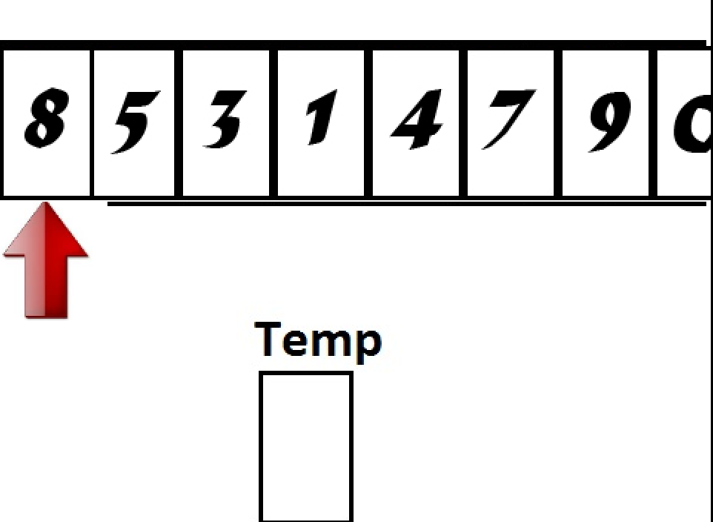
Insertion Sort: The algorithm

Slide 16
Insertion Sort: The algorithm
Input: An array A storing N items
Output: A sorted in ascending order

Slide 17
Algorithm Insertion_Sort (A, N):
For i = 1, i < N do {
current = A[i]
j = i
while A[j-1] > current
A[j] = A[j-1]
j = j-1
End while
A[j] = current
End for
Consider next element
Find correct position of current
Put current in correct position

Slide 18
Algorithm Insertion_Sort (A, N):
For i = 1, i < N do {
current = A[i]
j = i
while A[j-1] > current AND ??
A[j] = A[j-1]
j = j-1
End while
A[j] = current
End for

Slide 19
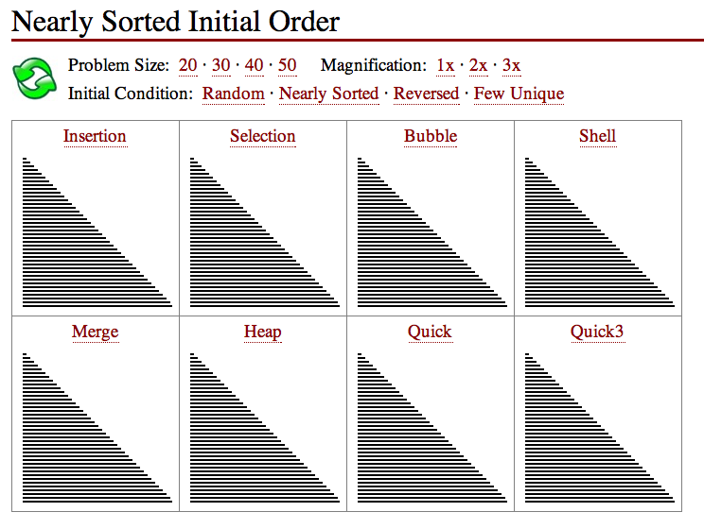

Slide 20
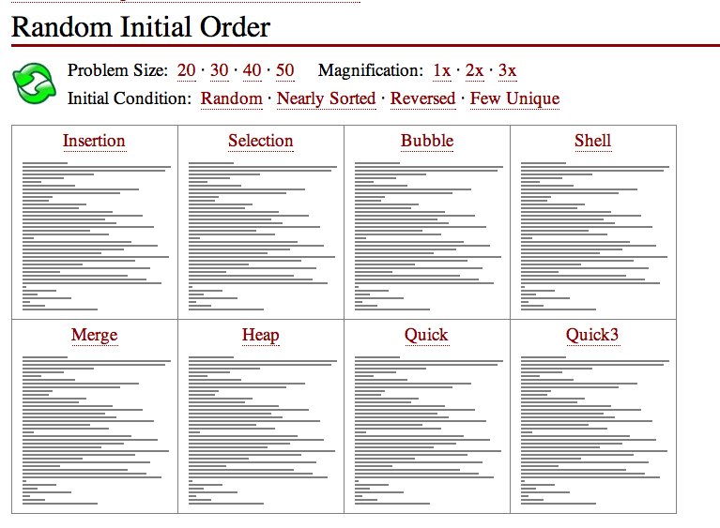

Slide 21
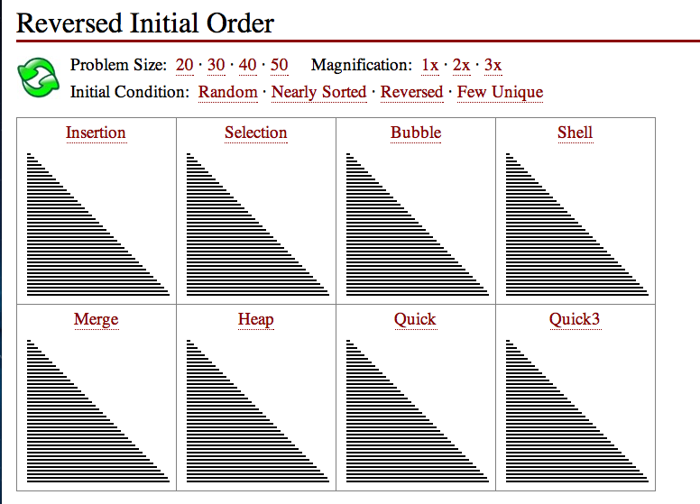

Slide 22
Sorting Algoriithms
Sorting demo
http://www.sorting-algorithms.com/

Slide 23
Merge Sort
Use the merge sort to sort these numbers
4
2
6
8
1
3
7
5

Slide 24
Merge Sort (Divide & Conquer)
4 2 6 8 1 3 7 5

Slide 25
Merge Sort (Divide & Conquer)
4 2 6 8 1 3 7 5
4 2 6 8
1 3 7 5

Slide 26
Merge Sort (Divide & Conquer)
4 2 6 8 1 3 7 5
4 2 6 8
1 3 7 5
4 2
6 8
1 3
7 5

Slide 27
Merge Sort (Divide & Conquer)
4 2 6 8 1 3 7 5
4 2 6 8
1 3 7 5
4 2
6 8
1 3
7 5
4
2
6
8
1
3
7
5

Slide 28
Merge Sort (Combine)
4
2
6
8
1
3
7
5

Slide 29
Merge Sort (Combine)
2 4
6 8
1 3
5 7
4
2
6
8
1
3
7
5

Slide 30
Merge Sort (Combine)
2 4 6 8
1 3 5 7
2 4
6 8
1 3
5 7
4
2
6
8
1
3
7
5

Slide 31
Merge Sort (Combine)
1 2 3 4 5 6 7 8
2 4 6 8
1 3 5 7
2 4
6 8
1 3
5 7
4
2
6
8
1
3
7
5

Slide 32
Thank You !

